Slide 1
EDINA Labs
Public Data visualisation
with Geoserver & Leaflet
EDINA 11/5/2016

Slide 2
Public Data visualisation
Public Data's just laying around these days
If you have access to it, why not do something with it?
GIS software is very advanced nowadays and can do many things on its own
Open Source solutions are industry-leading & cutting edge
  PostGIS
  Leaflet

Slide 3
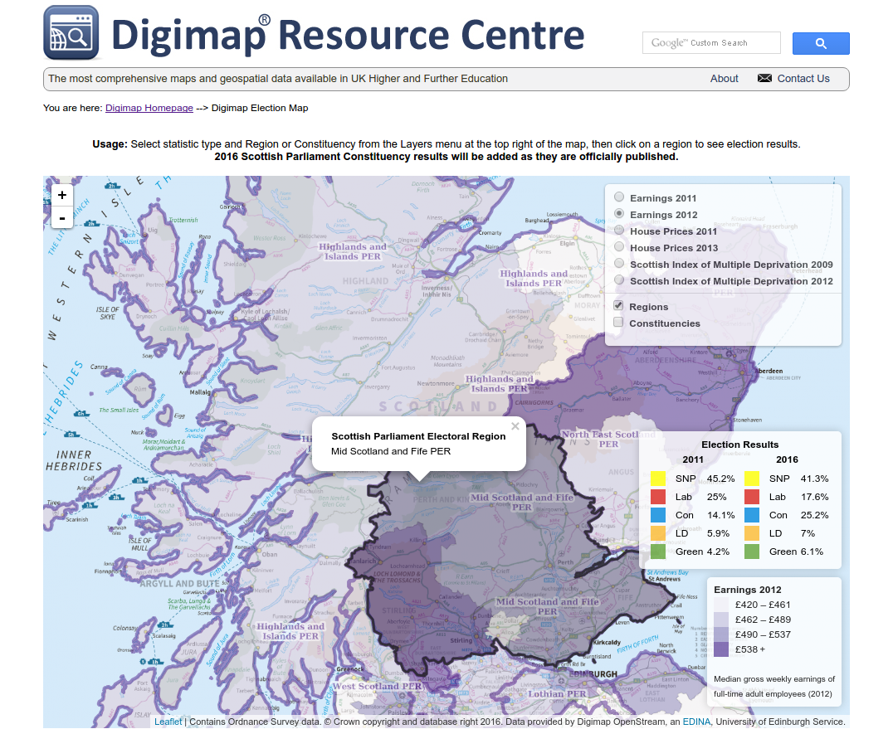

Slide 4
Where do we find public data?
Ordnance Survey
  https://www.ordnancesurvey.co.uk/business-and-government/products/boundary-line.html
    Also available on Digimap website (page 2 result on Google – SEO anyone?)
Scottish Government
  http://statistics.gov.scot/
Scottish Parliament
  http://www.parliament.scot/msps/election-results.aspx

Slide 5
Ordnance Survey Boundary-Line
Download shapefiles (.dbf, .prj, .shp, .shx)
Find relevant ones
  Regions
    scotland_and_wales_region_region
  Constituencies
    scotland_and_wales_const_region
  Council Areas
    district_borough_unitary_region
Import into GeoServer
  Import Data → Spatial Files → your shapefiles

Slide 6
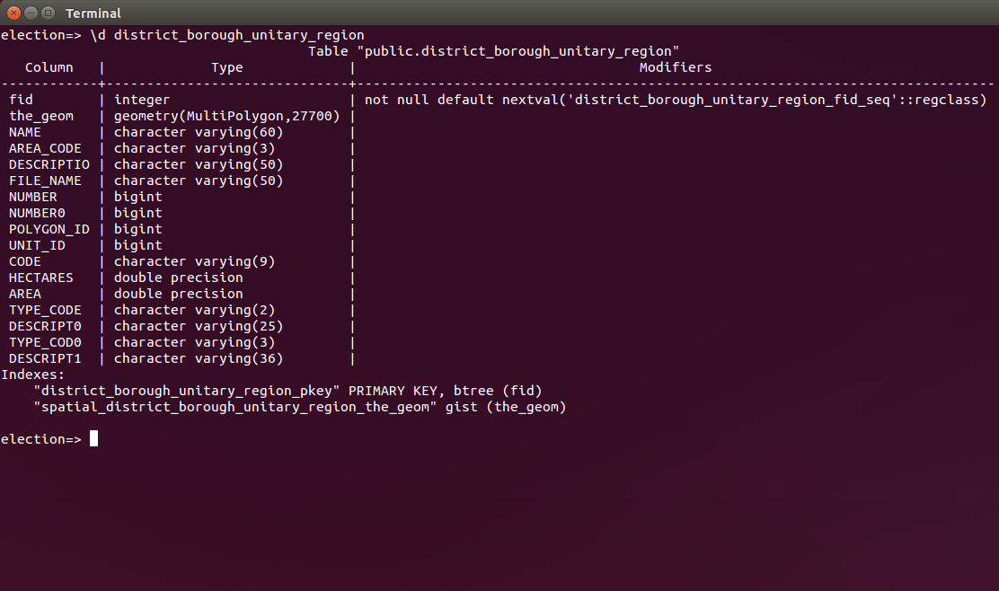
PostGIS

Slide 7
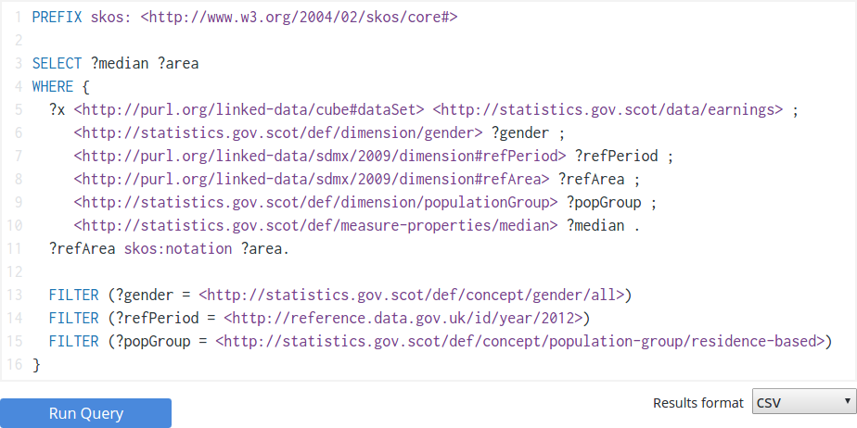
Statistics query
SPARQL! http://statistics.gov.scot/sparql

Slide 8
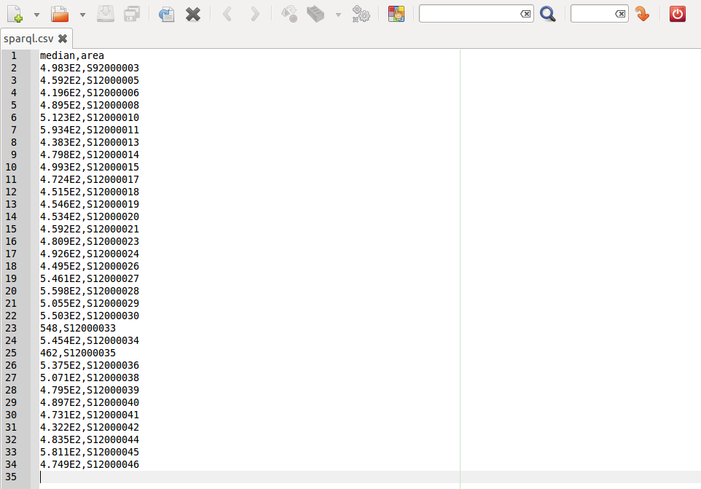
Statistics result
CSV!

Slide 9
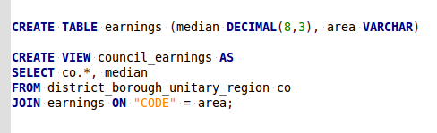
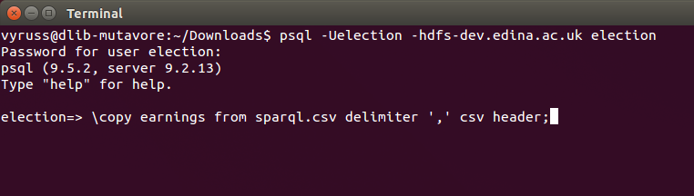
Import into PostgreSQL

Slide 10
Import view into GeoServer
View combines:
  PostGIS spatial data
  PostgreSQL plain data
Geoserver
  Stores → Add new Store → enter PostGIS details
  Layers → Add a new resource →
  → select your Store → publish your view

Slide 11
Styling
SLD: Styled Layer Descriptor (XML stylesheet)
OS offers SLDs :
  https://www.ordnancesurvey.co.uk/resources/carto-design/cartographic-stylesheets.html
  https://github.com/OrdnanceSurvey/Boundary-Line-stylesheets
You can define rules in SLDs!
Add to Geoserver
  Styles → Add a new style
  Layers → Publishing → Default Style

Slide 12
Leaflet
Official site
  http://leafletjs.com/
OS use EPSG:27700 projection
  We need Proj4Leaflet
  http://kartena.github.io/Proj4Leaflet/

Slide 13
Let's look at the code
Components:
  PostgreSQL
  PostGIS
  GeoServer
  JavaScript libraries (Leaflet, Proj4Leaflet, jQuery)
  Plain HTML!
  Served over nginx

Slide 14
GitHub
This workshop:
  https://github.com/vyruss/edinalabs/tree/master/2016-05-11 Public Data visualisation with Geoserver & Leaflet
EDINA Labs:
  https://github.com/vyruss/edinalabs/

